Slide 1
APIs and API Management
Oxford University
Software Engineering Programme
April 2021

Slide 2

The Breakup of the Corporation

Slide 3
APIs
An API is a business capability delivered over the Internet to internal or external consumers
Network accessible function
Available using standard web protocols
With well-defined interfaces
Designed for access by third-parties
A Managed API is:
Actively advertised and subscribe-able
Available with SLAs
Secured, authenticated, authorized and protected
Monitored and monetized with analytics

Slide 4
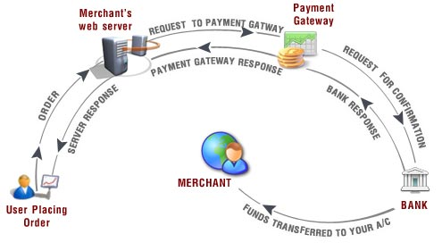
APIs All the Way…

Slide 5
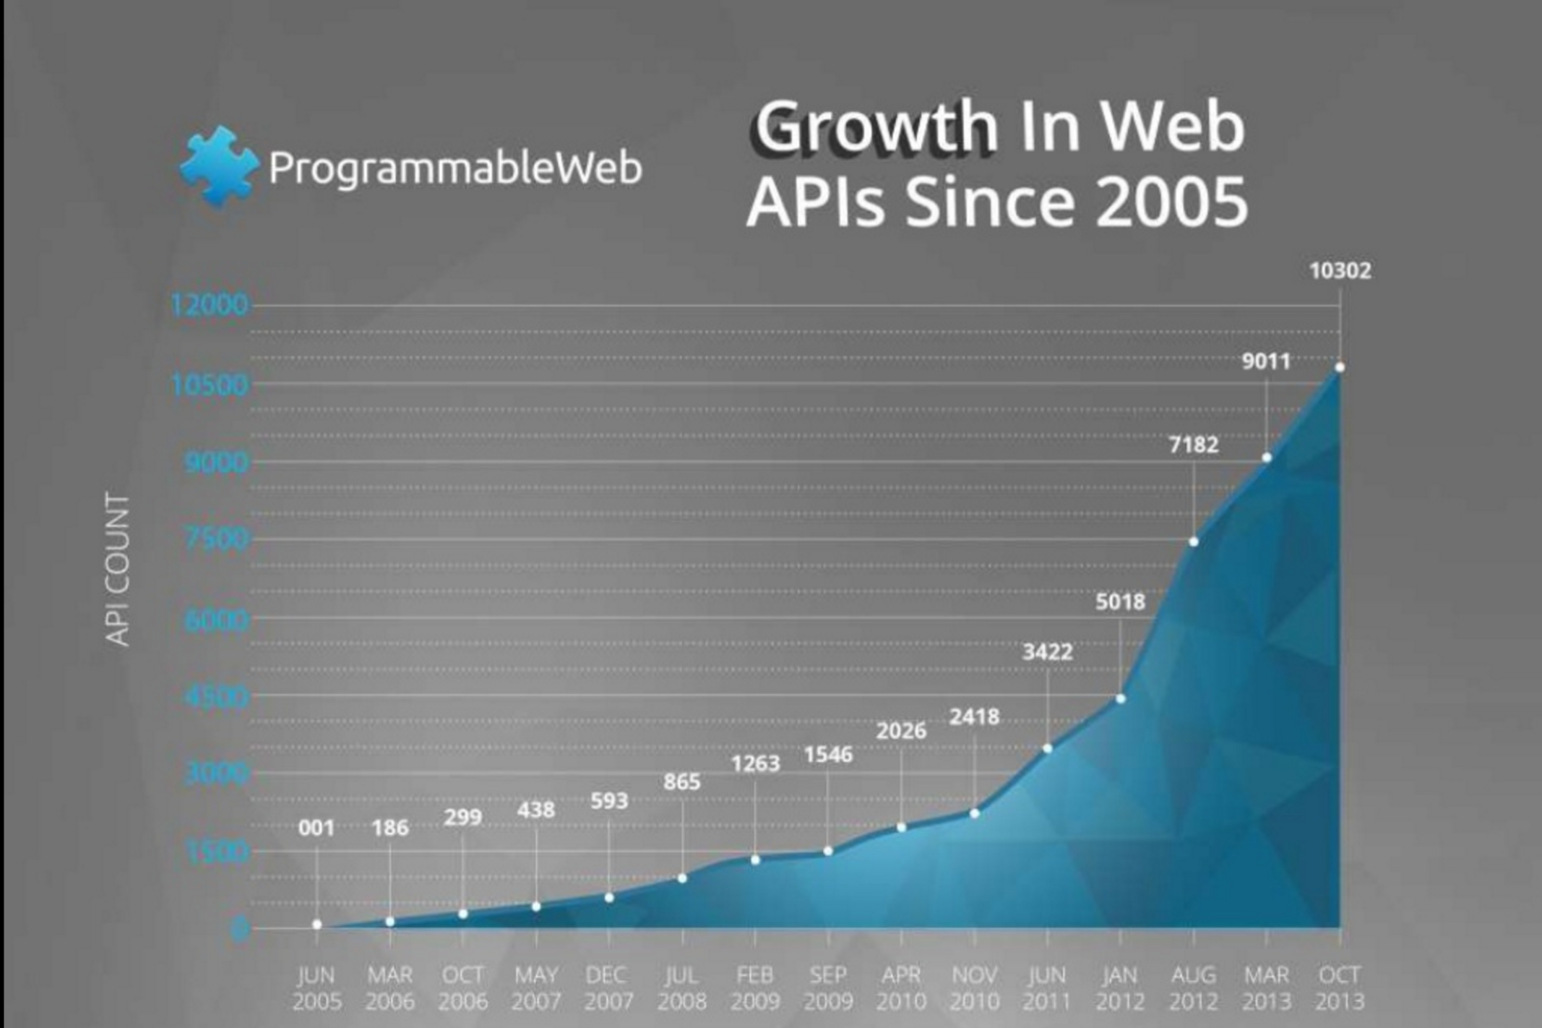

Slide 6





Some statistics (3-5 years old)
Twitter : More than 15 billion calls per day 75% through APIs
Netflix : More than 1 billion calls per day
Facebook : More than 5 billion calls per day
Amazon : More than 260 billion objects store in S3
eBay : More than 6 billion transactions per day

Slide 7
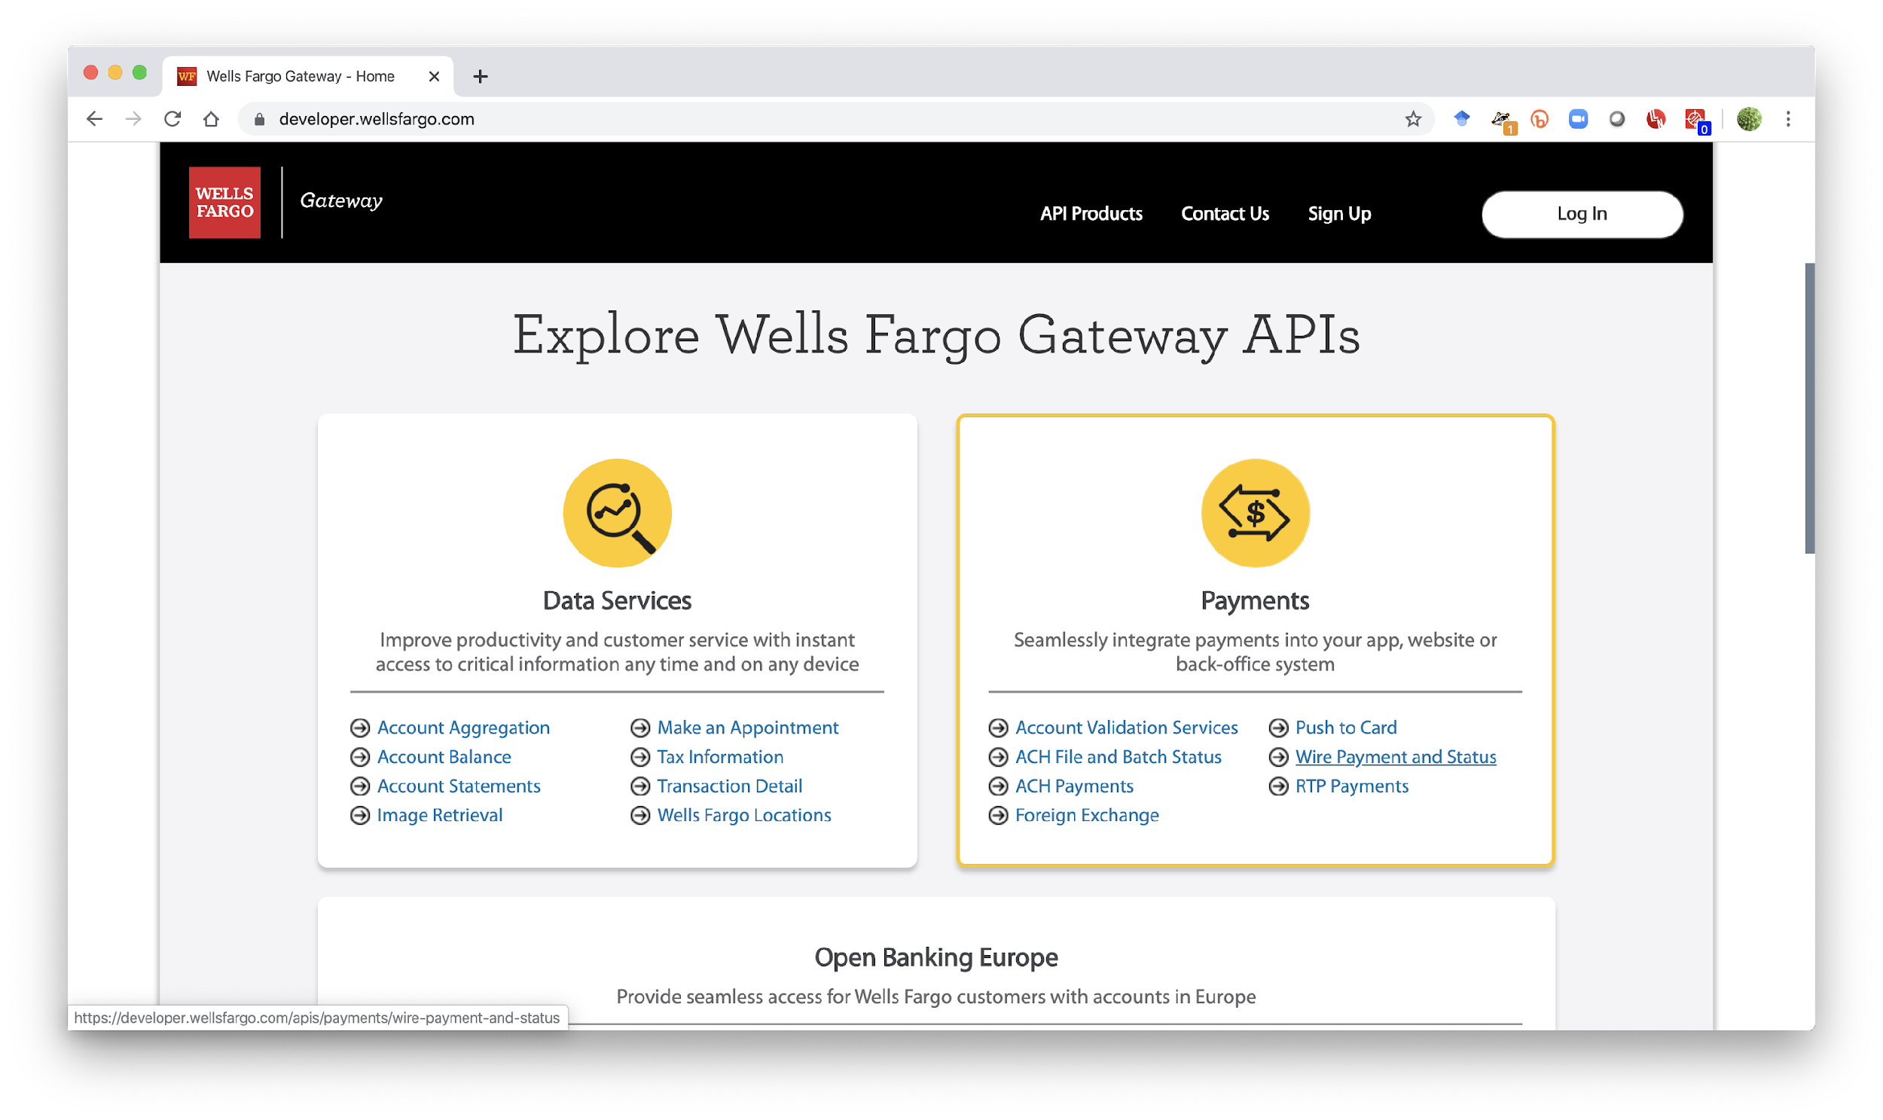

Slide 8


The role of APIs
Delivering safer commuter experiences.
APIs integrate road, rail, and commuter systems to fuel data intelligence and decision making.

Slide 9
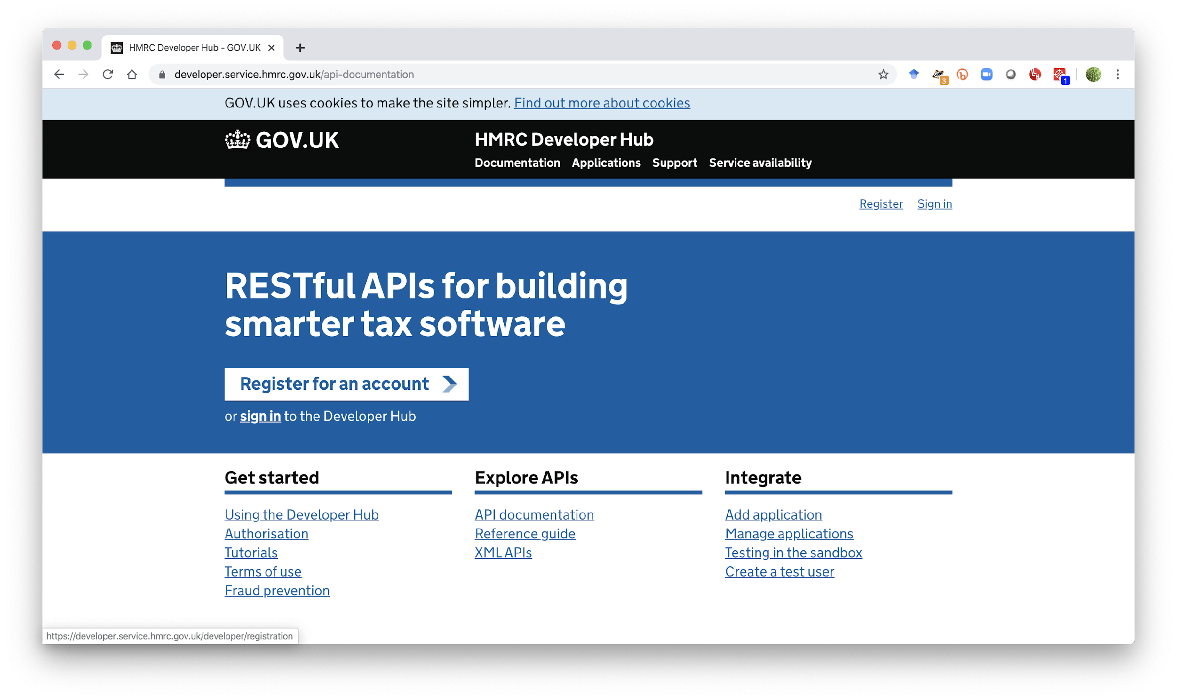

Slide 10
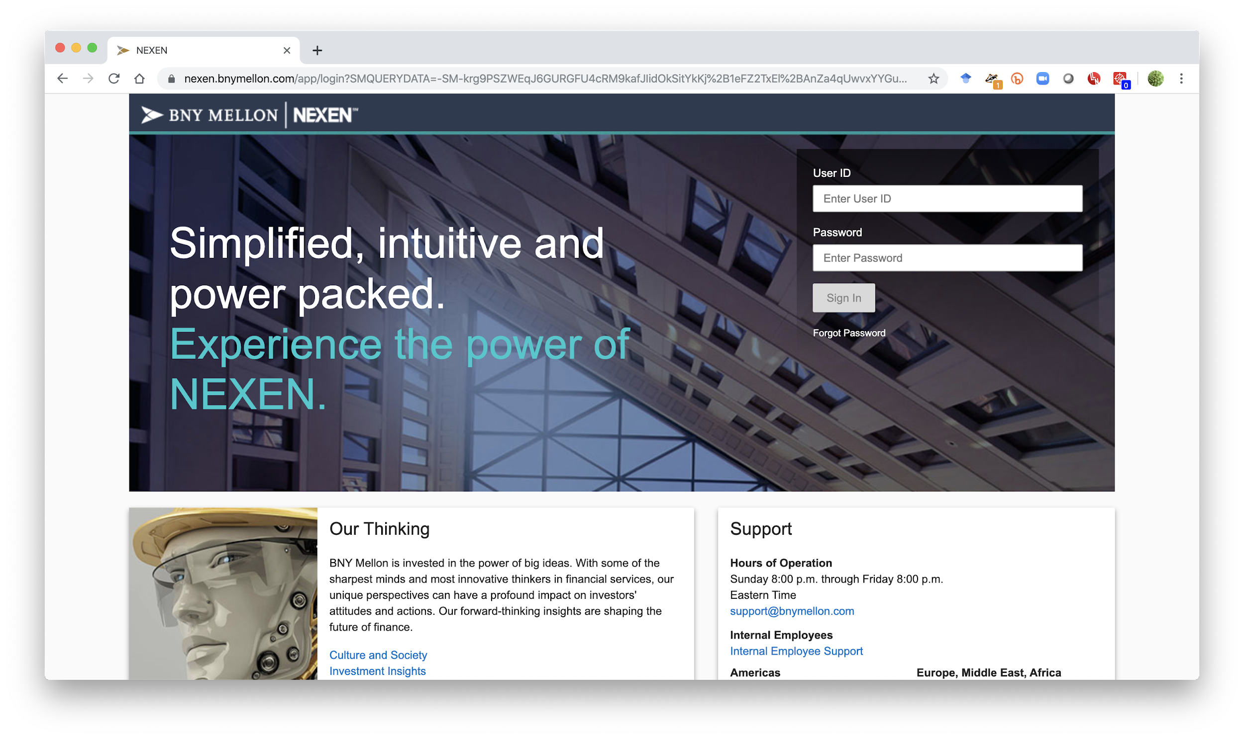

Slide 11
BNY Mellon
$33,000,000,000,000
assets in custody

Slide 12
“We want to blur the lines between our technology and our customers”
Jonathan Pearl,
Director and Global Head,
NEXEN Platform Management,
BNY Mellon

Slide 13
The Global Impact
APIs now account for 25% of the Internet’s traffic.
$1 trillion is up for grabs through the redistribution of revenue through APIs (McKinsey 2017).
25% of revenue flows through APIs (Vanson Bourne 2018).

Slide 14
“
APIs create business agility that fosters the rapid business reconfiguration necessary to continually adapt to an unknown future of constant change.
- Randy Heffner
Forrester Research
Notes:
If you haven’t heard, integration - traditionally the most unloved sector of enterprise software - is sexy again. The rise of numerous iPaaS vendors, more than $1B in recent VC investments into integration vendors and MuleSoft’s acquisition by CRM has created a renewed interest in one of the largest and oldest segments of enterprise software.
** Slide - include the quote from Massimo, and perhaps a graph of the recent VC investments in the integration space? We could also show the recent integration M&A activity from the past year. **
Why is this?????

Slide 15
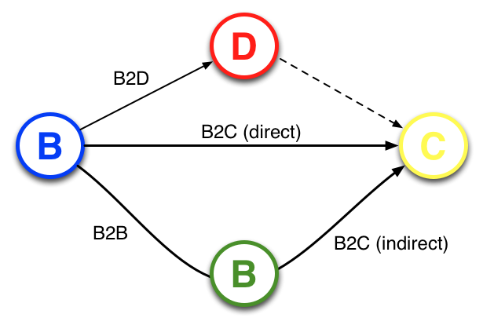
API Opportunities
“APIs create a new relationship opportunity –
B2D; Business to Developer, that creates
direct B2C, B2B and indirect B2C relations”

Slide 16
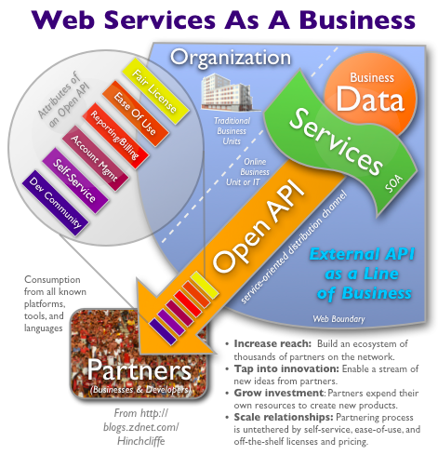
Running your SOA like a Web startup
http://www.zdnet.com/blog/hinchcliffe/running-your-soa-like-a-web-startup/525

Slide 17
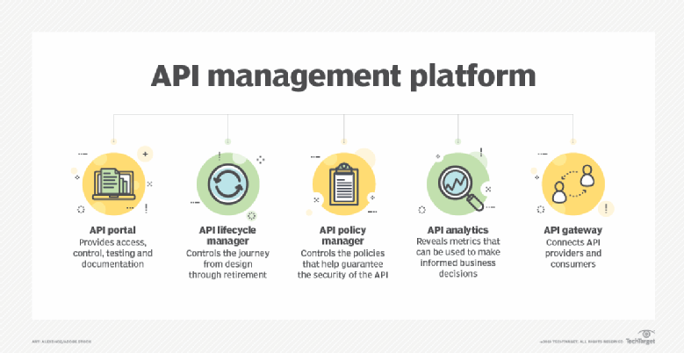
API Management
https://searchapparchitecture.techtarget.com/definition/API-management

Slide 18
API Management benefits
Storefront
Prototyping and fast feedback
Aggregation and virtualisation
Versioning
Documentation
Key issuing and management
Transparent OAuth2, JWT
Workflows
On-boarding, subscription, approval
Throttling and monetisation
Analytics

Slide 19
Questions?

